Slide 1

Simulating Hardware Error Attacks on AI
Satrant Bains, Liam Baker, Alex Fink, Kieran Seven
Notes:
Satrant
Exploring AI’s Robustness through Error Simulations
Explicitly state research project

Slide 2

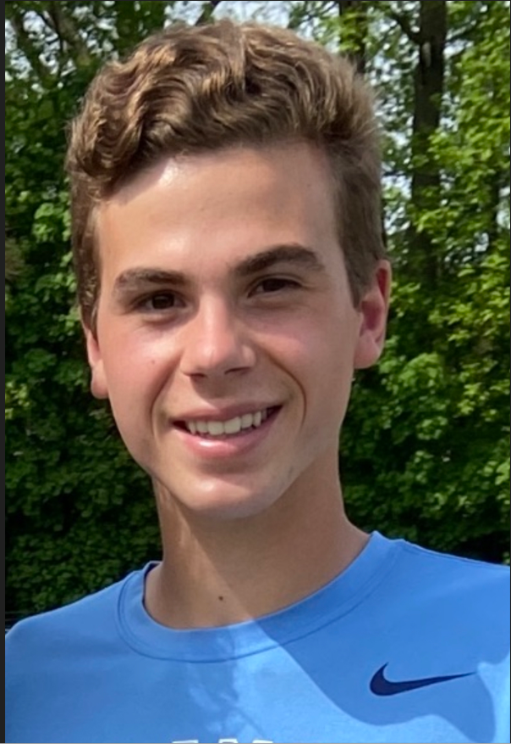
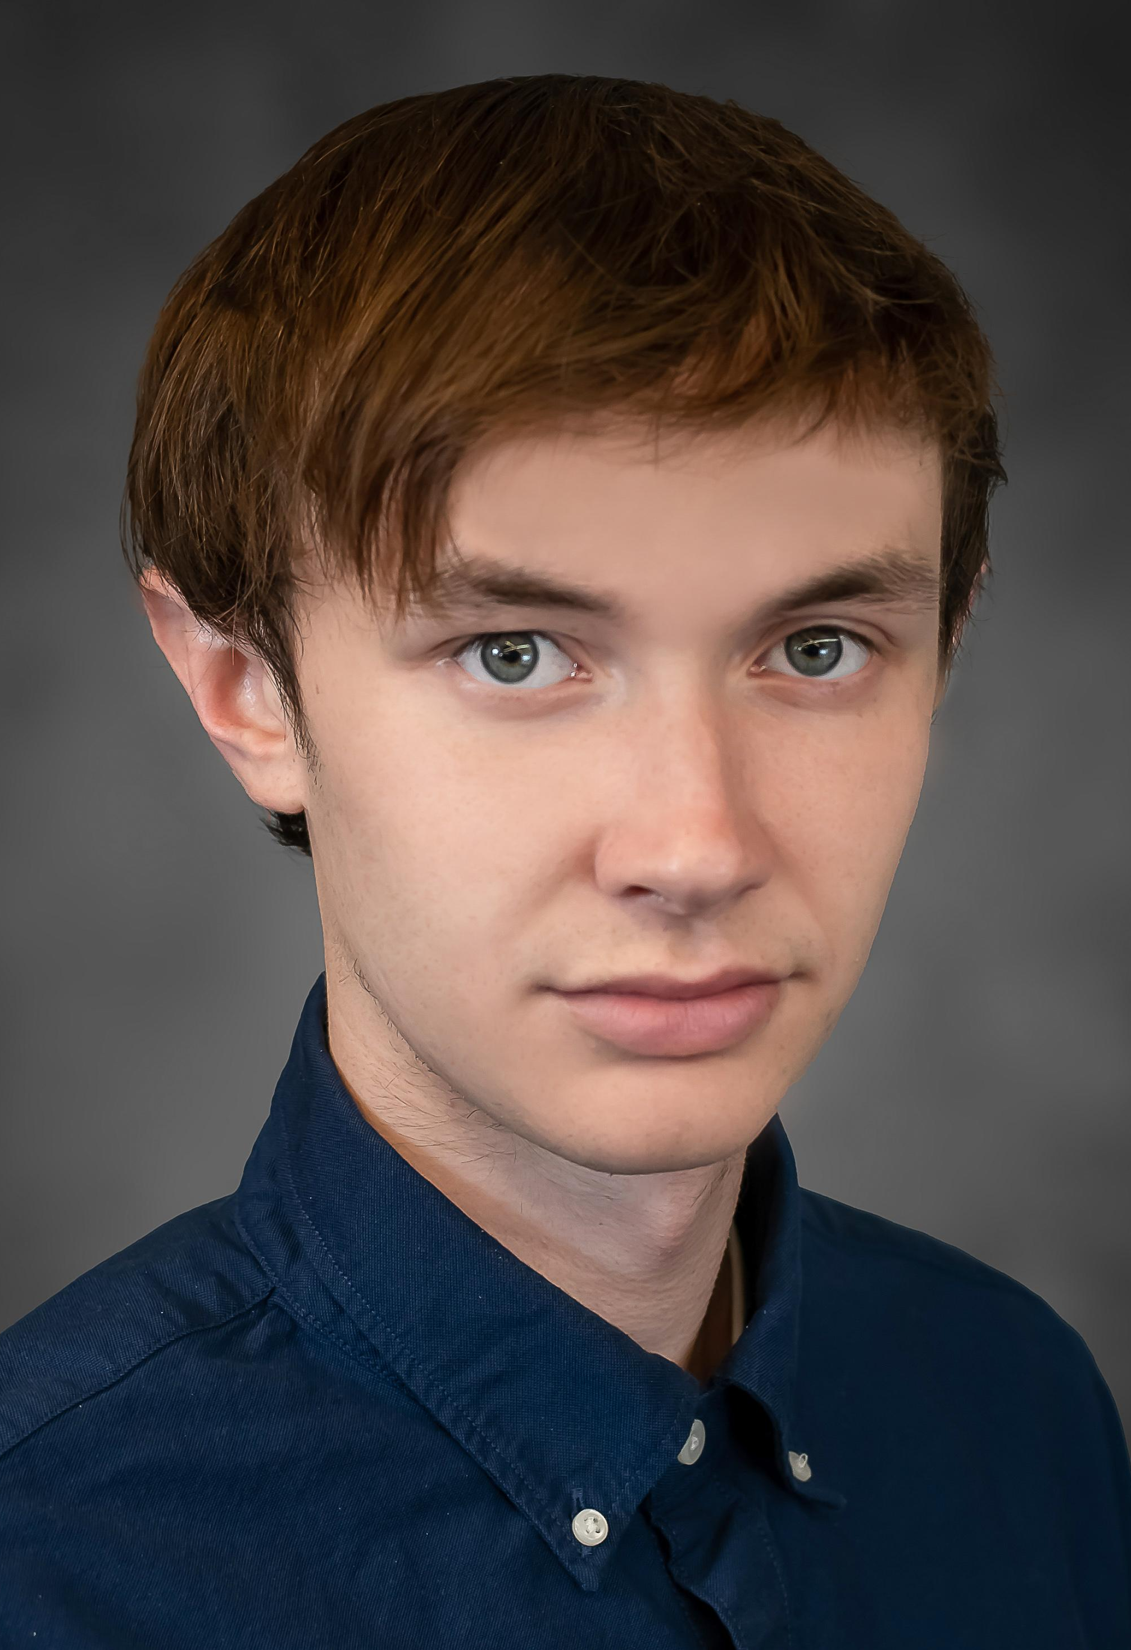
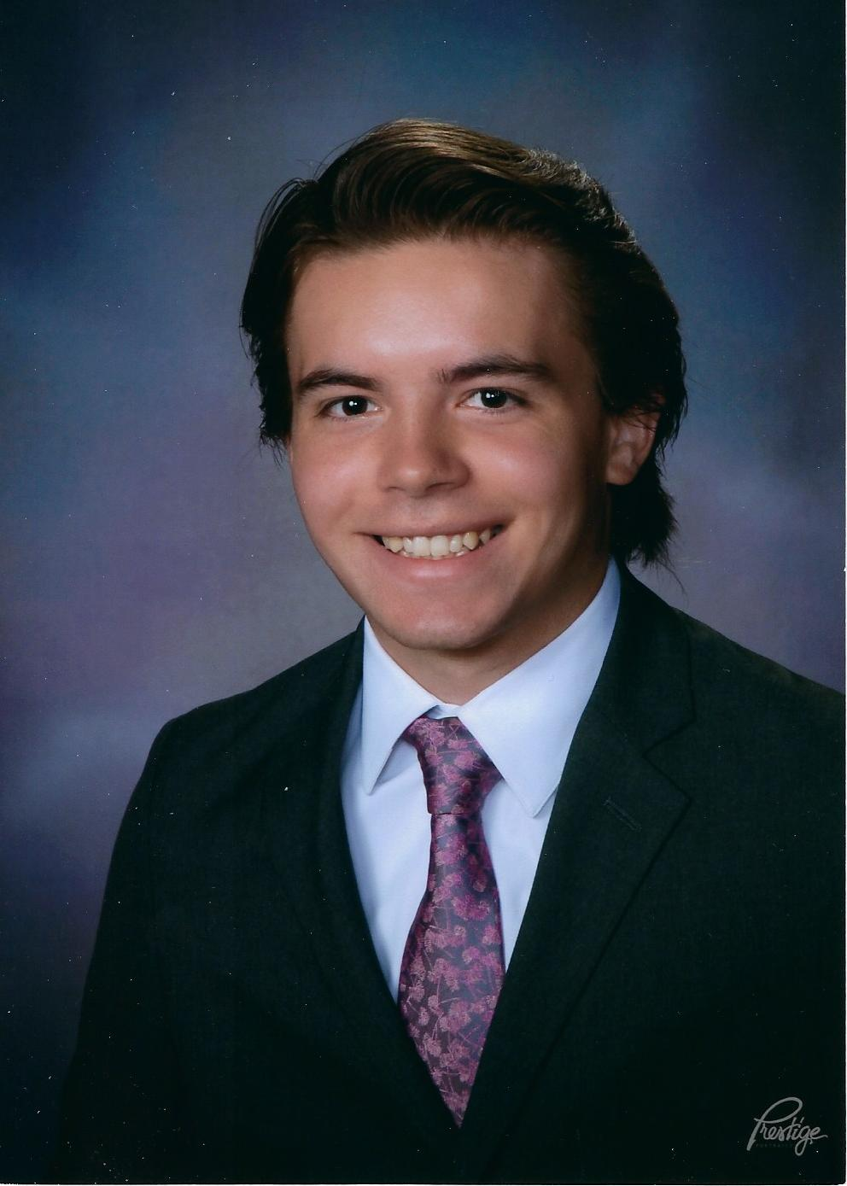
Meet the Team
Satrant Bains
Junior
Computer Engineer
Developer
Liam Baker
Junior
Computer Engineer
Developer
Kieran Seven
Sophomore
Computer Engineer
Developer
Alex Fink
Junior
Computer Engineer
Developer

Slide 3
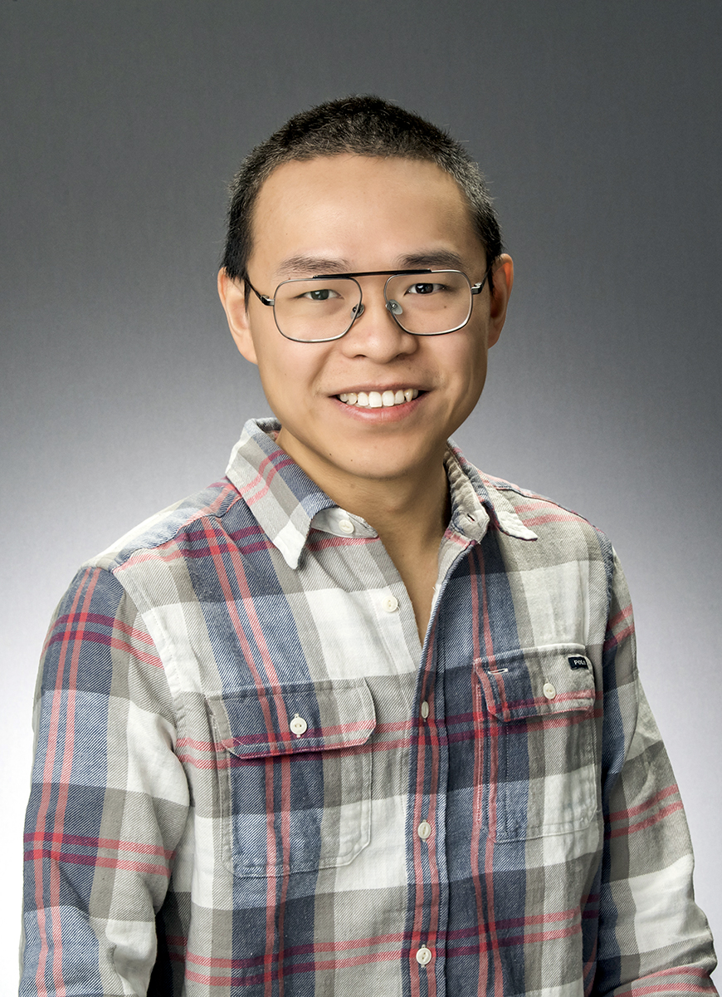
Faculty Mentor: Dr. Xun Jiao
Dr. Jiao is an assistant professor in the ECE department who specializes in Machine Learning/AI
Research sponsored by the NIH, NHS, L3Harris and NVIDIA
PH.D UC San Diego, 2018
B.S Queen Mary, University of London, 2013
B.S Beijing University of Posts and Telecommunication, 2013
Notes:
Alex

Slide 4
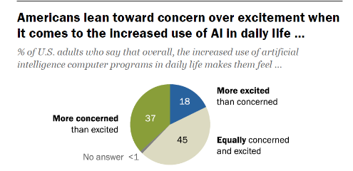
Problem Statement
Developers don't know the limits of AI.
The public is concerned about increased AI usage.
Sam Altman has said "we've got to be careful" and "I think [the general public] should be happy that we are a little bit scared of this."
We need more toolkits to understand the robustness of AI.
What are the limits of emerging AI technology?
What do failures in AI technology entail for us?
Notes:
Satrant
Car that built itself, the people that built it don't really know how it did it.
What we’re doing is helping them find out what it is made of and where it can fail
We’re curious?
Timeline has been very short and there hasn’t been a full assessment of its abilities, very few are looking at the vulnerabilities. Shining the light on the vulnerabilities, everyone else is doing optimization.

Slide 5
Artificial Intelligence
Computer Vision
Natural Language Processing:
AI technology that gives computers the ability to comprehend human language.
Data Analytics
Self-Driving Cars
Tesla Autopilot
Traffic Analysis
Chatbots: ChatGPT,
Speech-to-text
Google Search
Personalized Advertisement Stock Market Trends
Notes:
Alex

Slide 6
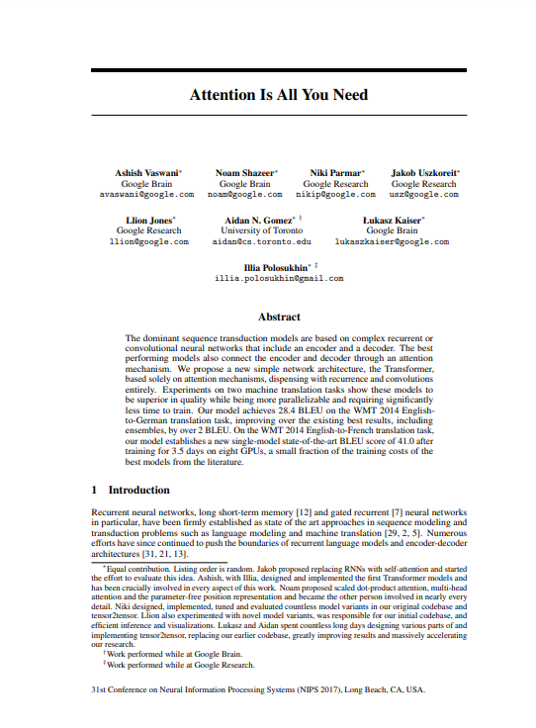
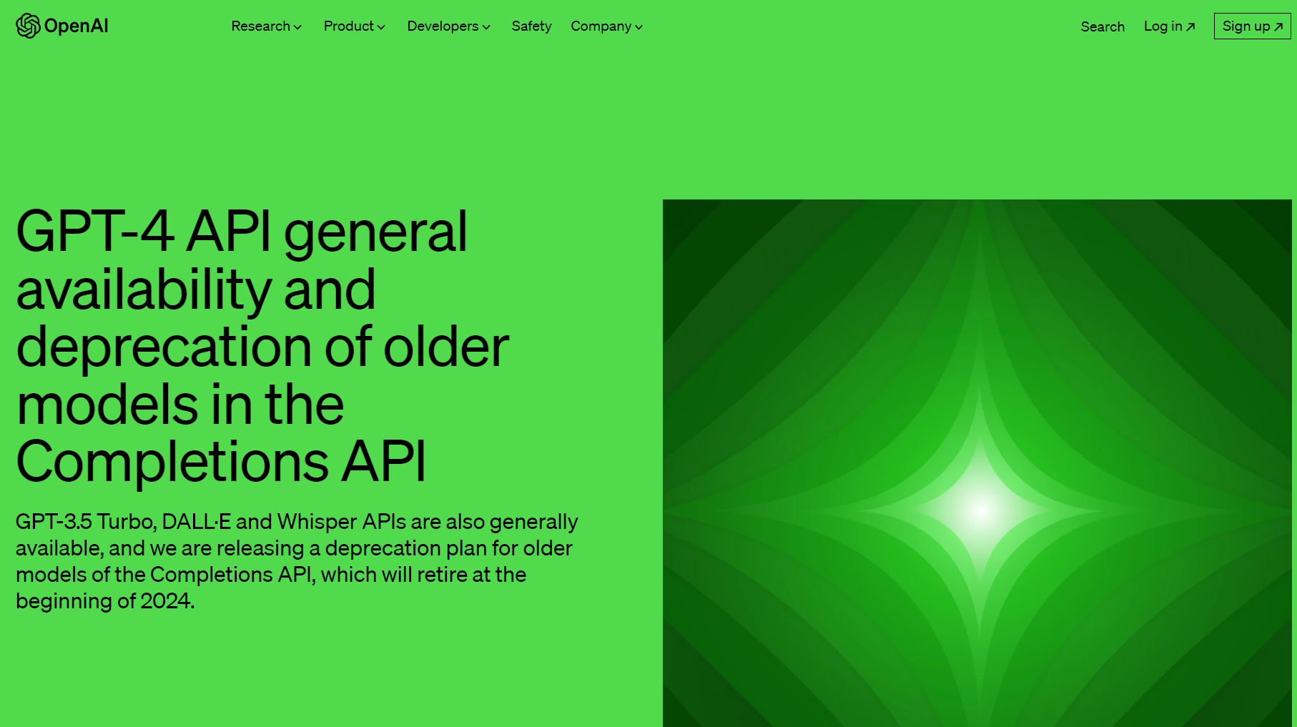
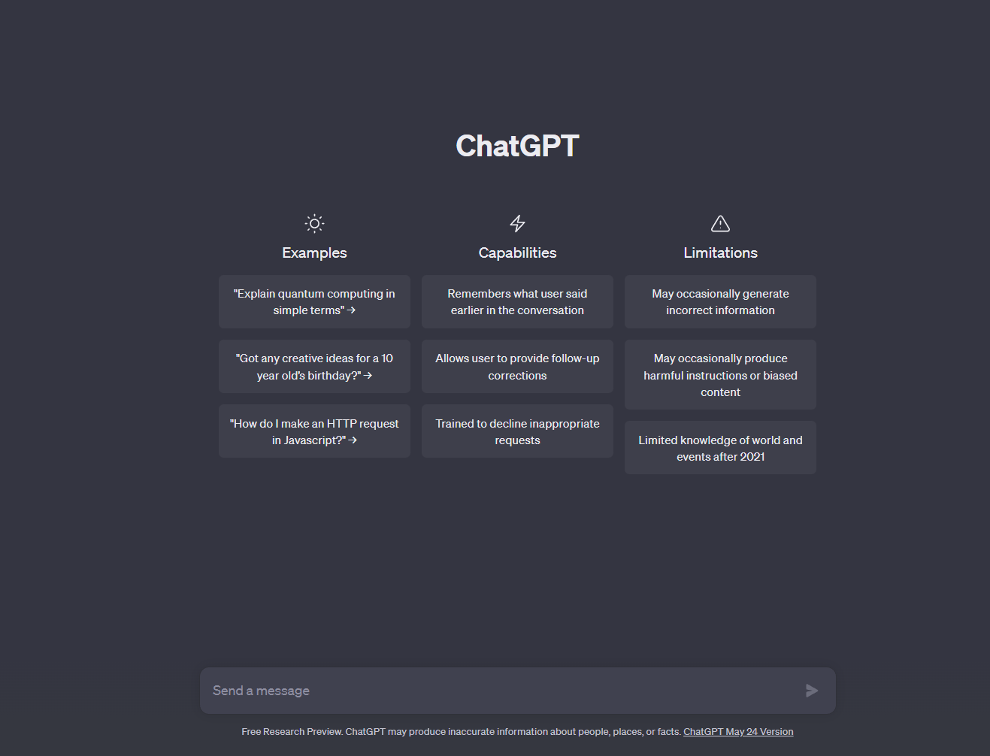
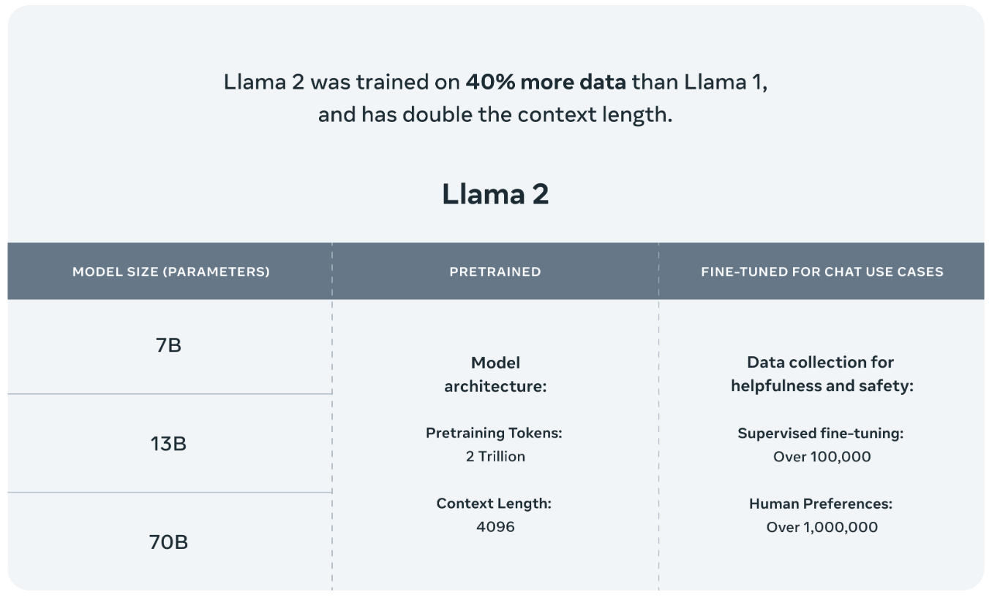
Timeline
Meta's LLaMa v2 is open sourced
Natural language Processing is first considered for translating between languages
ChatGPT is released
June 12, 2017
July 10, 2023
1940s
November 30, 2022
July 18, 2023
OpenAI's GPT-4's API is released
Paper describing the GPT architecture is published in "Attention is All You Need"
Notes:
Satrant
Very fast moving development after a fairly long history of being around.
Very recent explosion has caused massive interest to be drawn to NLP so there is just not that much info about.

Slide 7
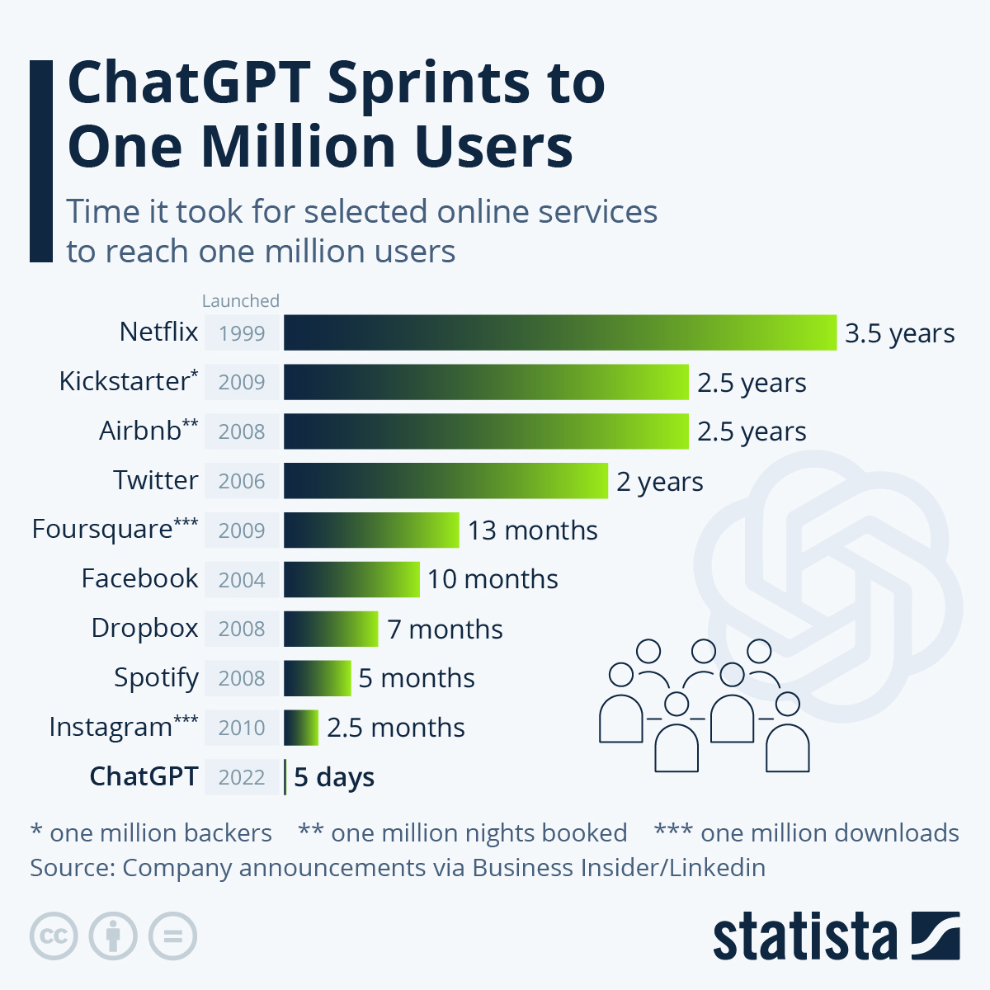
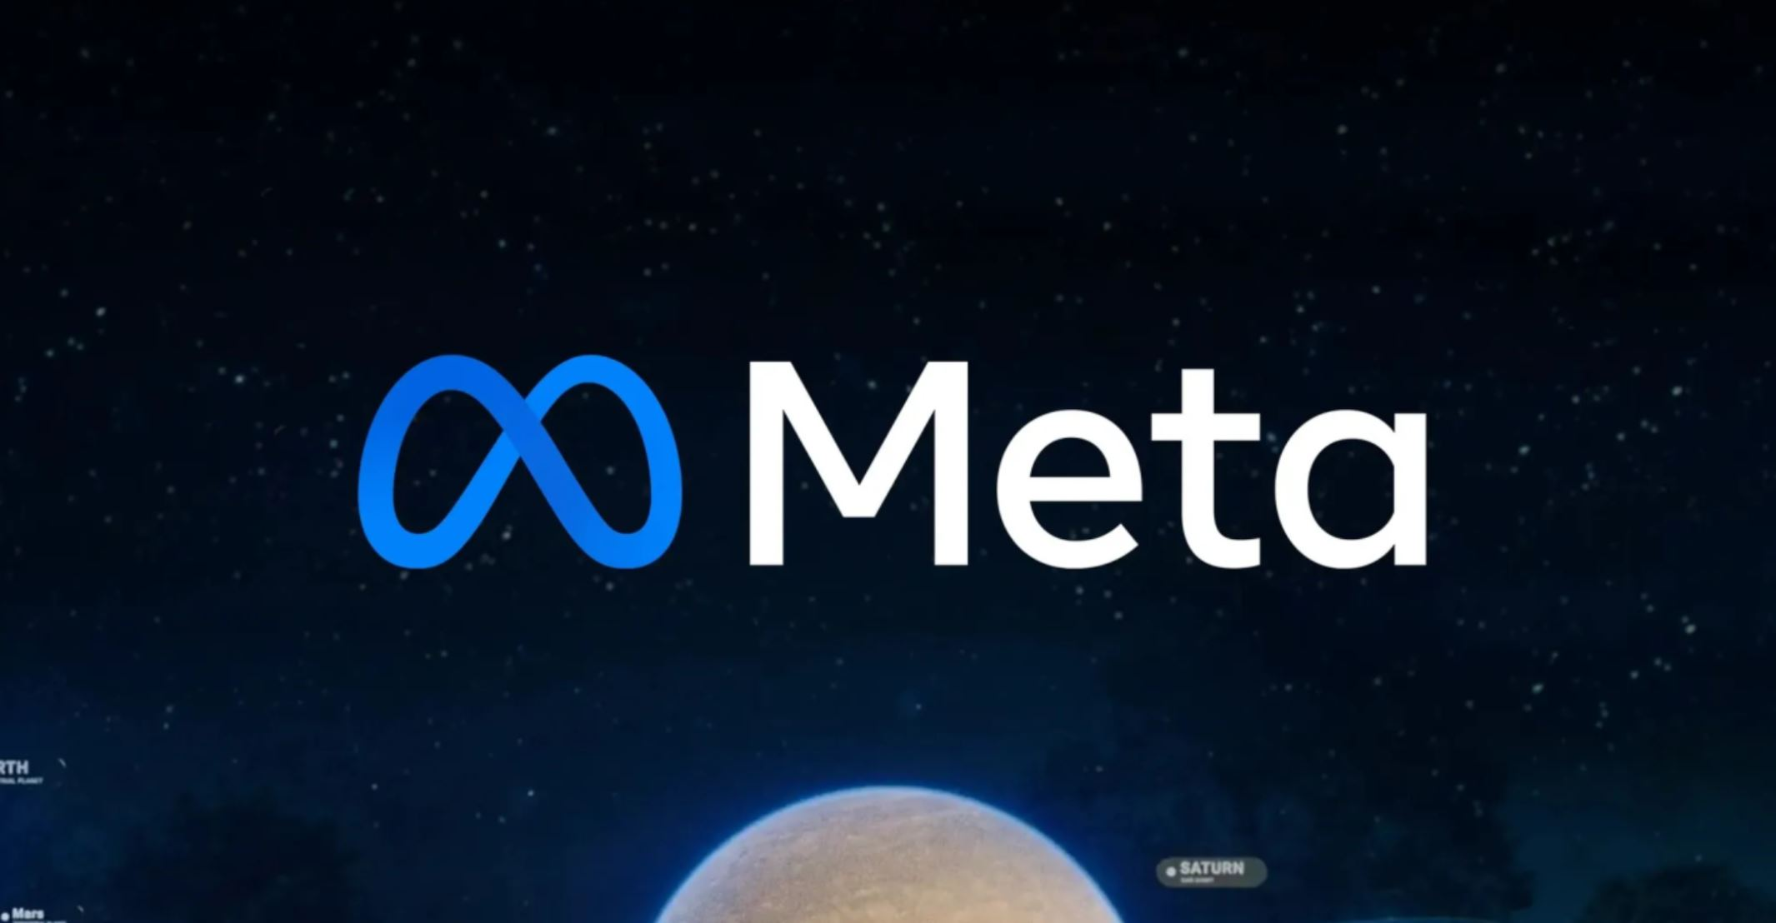
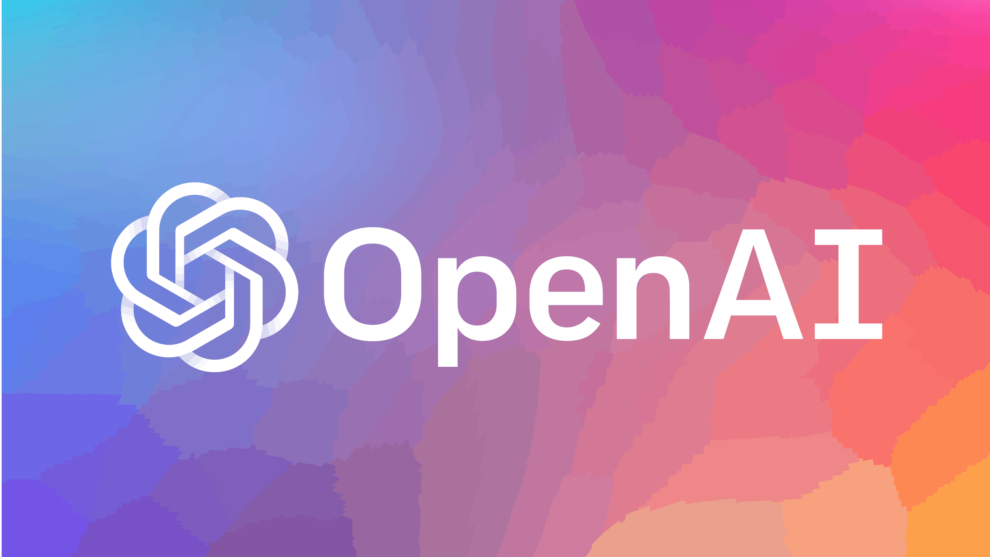

Market
Microsoft invested $1,000,000,000 into OpenAI.
Google invested $300,000,000 into Anthropic a competitor of OpenAI.
Global total corporate AI investment from 2022 is 91.9 billion
Notes:
- ChatGPT has exploded the market for the NLP space, reaching 1 million users in just 5 days. much faster than other big tech companies
- Microsoft and Google are investing a ton of money into the NLP model space
- This goes to show how serious this technology is
- and how it has the potential to be in every business around the world
- Our product is geared towards helping developers understand the limits of these language models and the robustness, or how resistant they are to making mistakes
- A lot of companies are focusing on getting their model to be more advanced and safe as quickly as possible.
- But they may be ignoring potential weaknesses from hardware errors.
- Our research on the impact of these hardware errors specifically on NLP models is the first of its kind in this space.

Slide 8
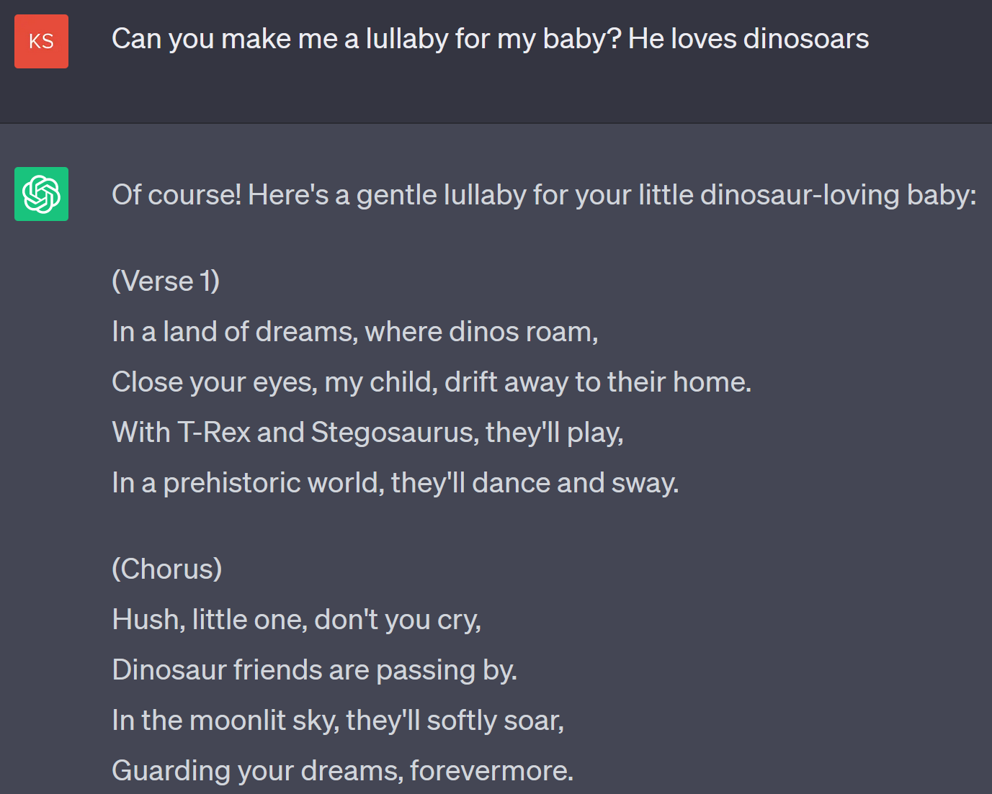
ChatGPT
Text Generation Example

Slide 9
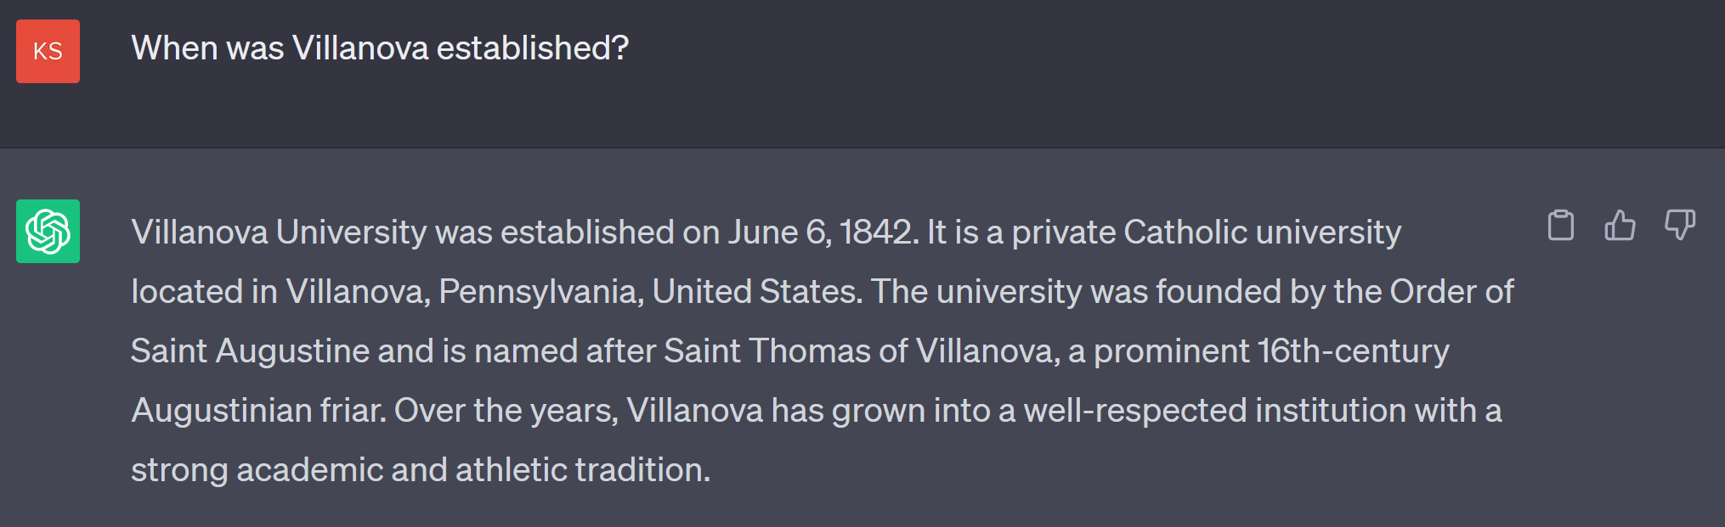
Factual Example

Slide 10
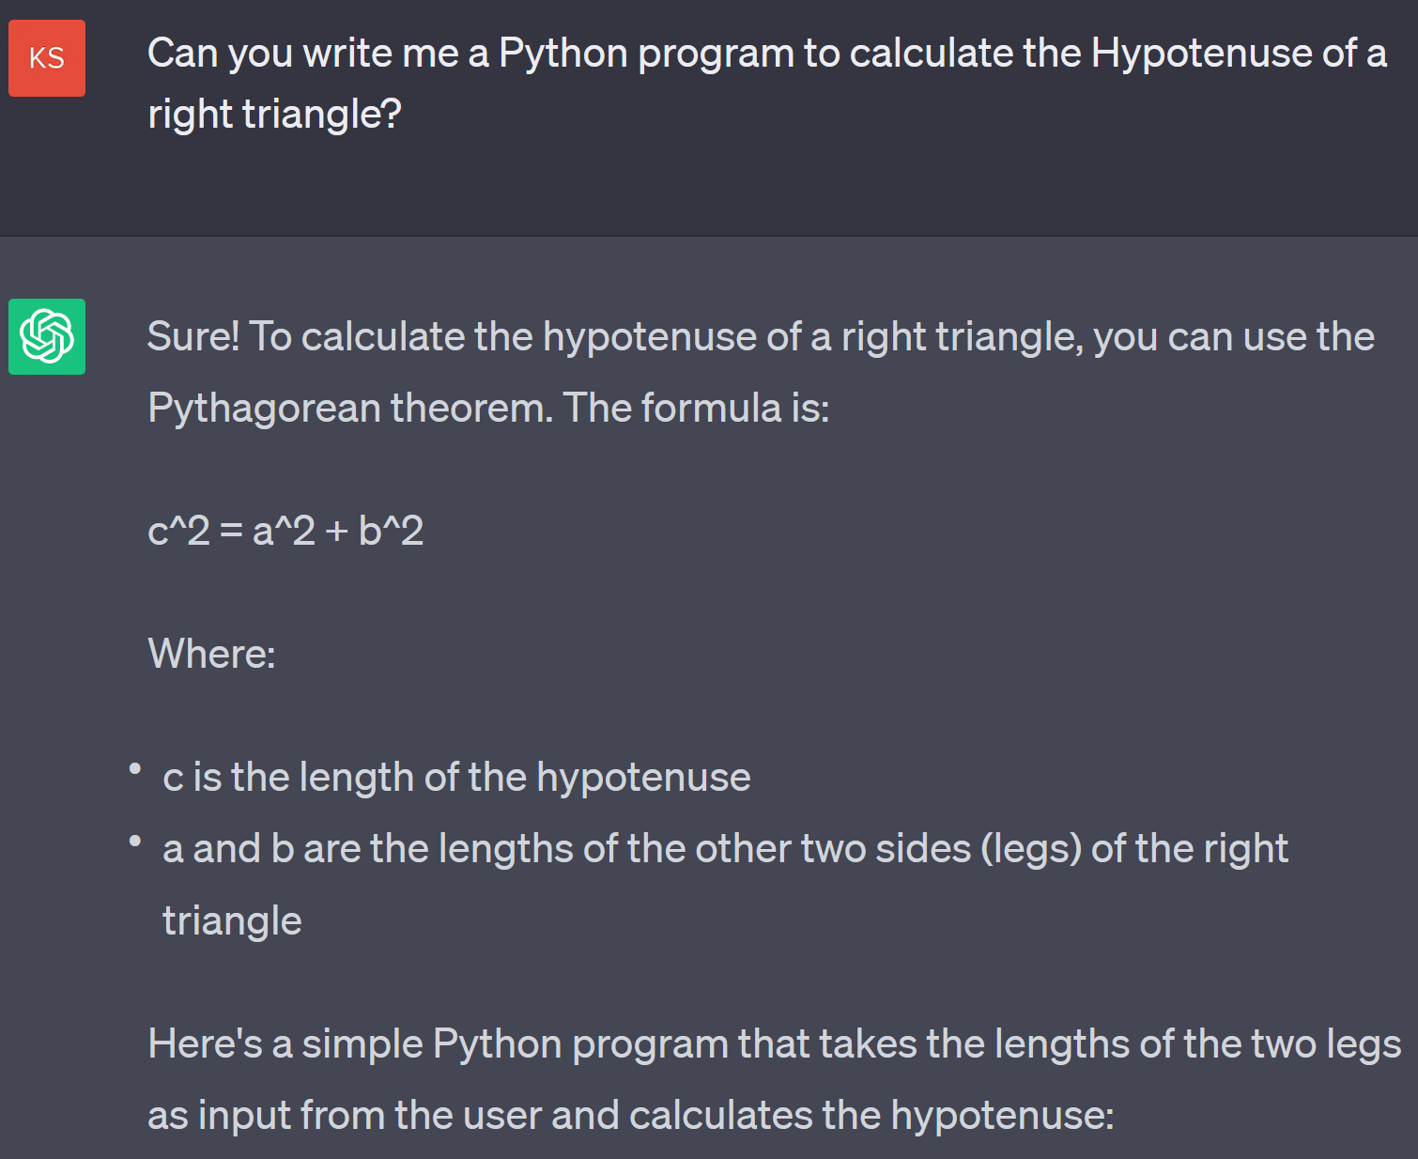
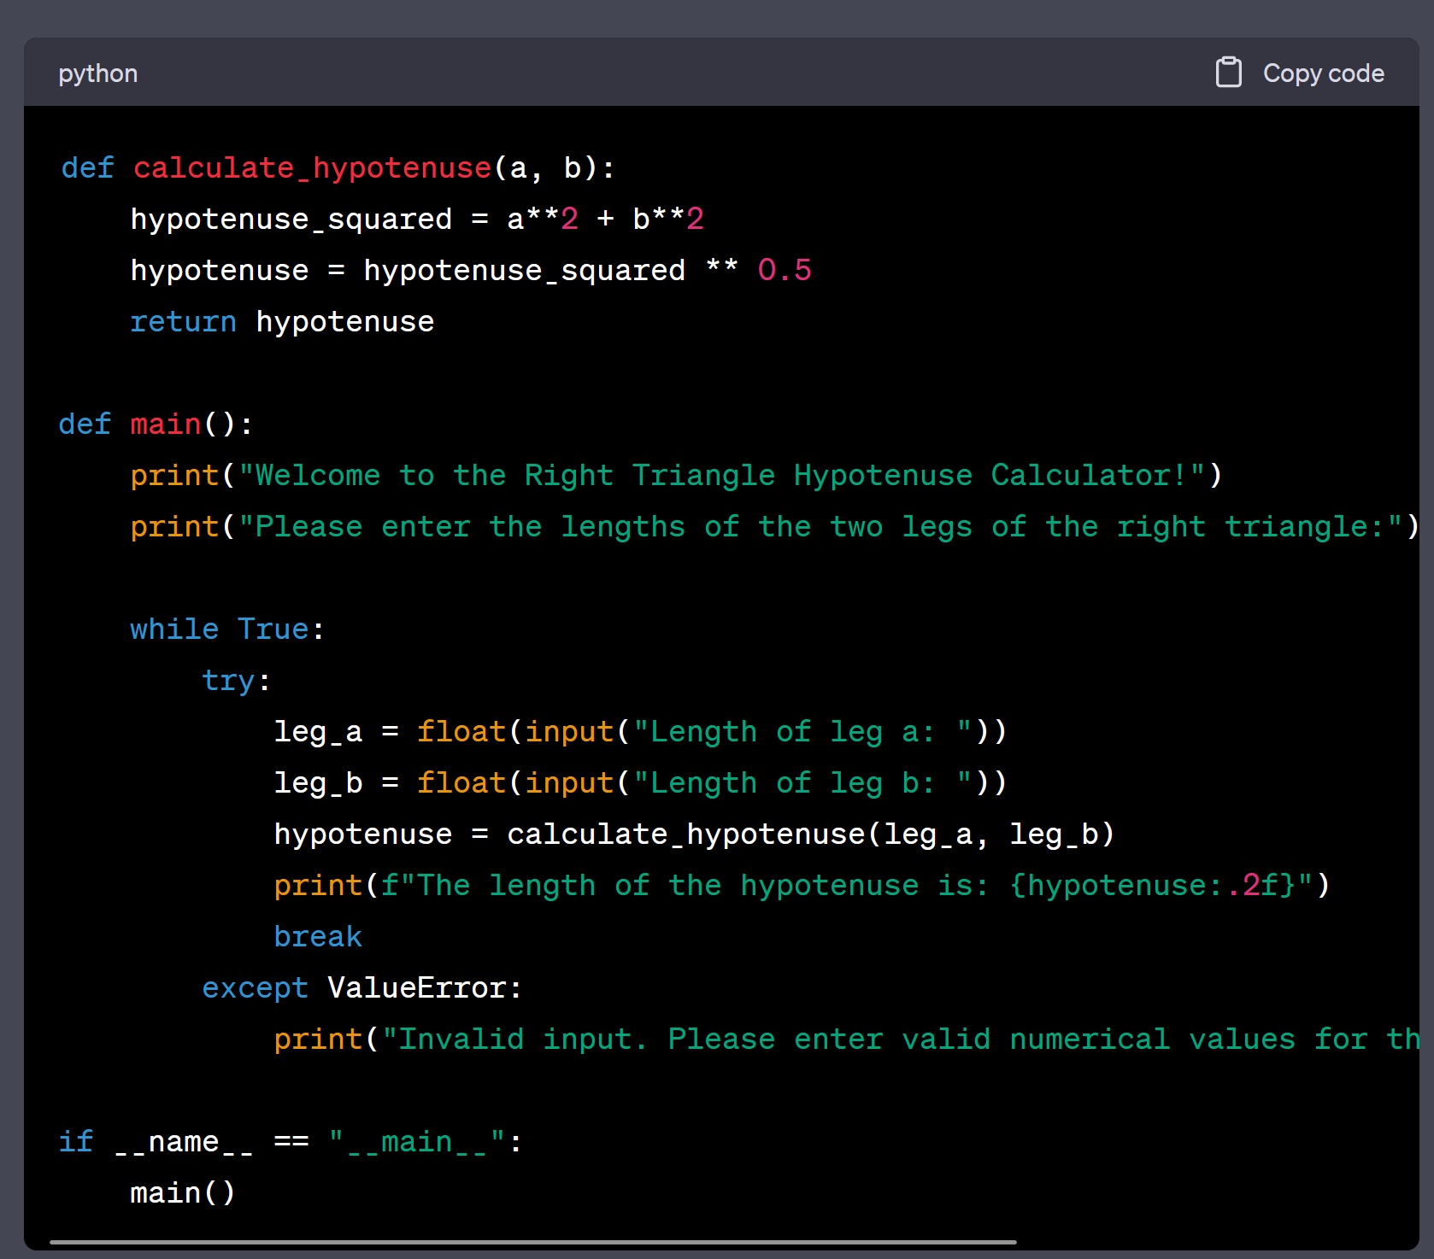
Code Example

Slide 11
Our Solution
Our goal is to design a model that can simulate hardware attacks through software
Analyze the source code for pre-existing NLP models and create a tool that can cause bit flip errors.
Create website to show the difference between NLP models with and without hardware errors.
Notes:
- In order to answer the question, what are the limits of language models, we will focus on hardware errors, specifically bit flips; and their impact on the responses of the Chatbots.
- To do this, we will be simulating hardware errors through software instead of creating them at the hardware level
- We will be injecting the errors into the layers of the language model
- To make our tool accessible, we will make a website that can clearly show the impact of the errors through chatbots

Slide 12
Innovation
Companies focus on optimizing their models.
Getting their model to be as advanced and safe as fast as possible
We are researching the consequences of hardware vulnerabilities in NLP.
Our tool is geared towards helping developers understand the limits and robustness of language models

Slide 13
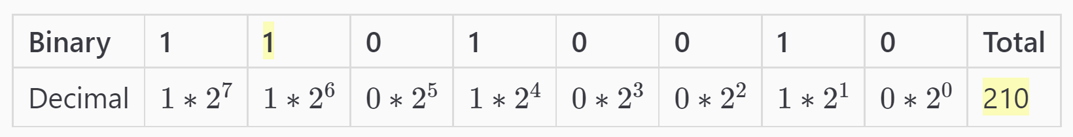
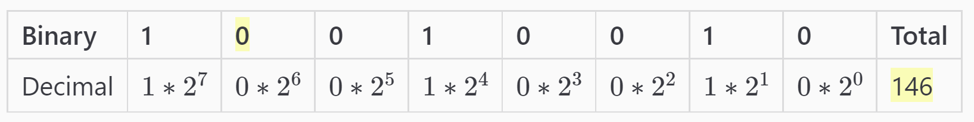


Relevance
Our simulated errors focus on bit flips which are flips in a transistor caused by manufacturing errors or random transient events.
During a Belgian Government Election in 2003, a cosmic ray from space hit the hardware that the voting system was run on
The number of votes for one candidate to increased by 4096
Due to a bit flip from 0 to 1.
With AI models becoming more important in society’s daily life, understanding the impact that these hardware errors can have on these models is necessary to improve upon existing AI technology.
Notes:
Liam
Introduce bitflips before story and there impact in our project. Connect story to our project

Slide 14
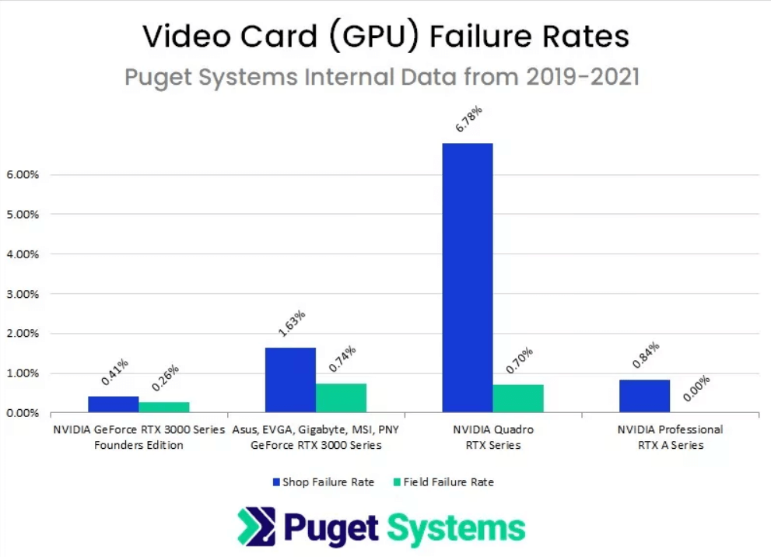
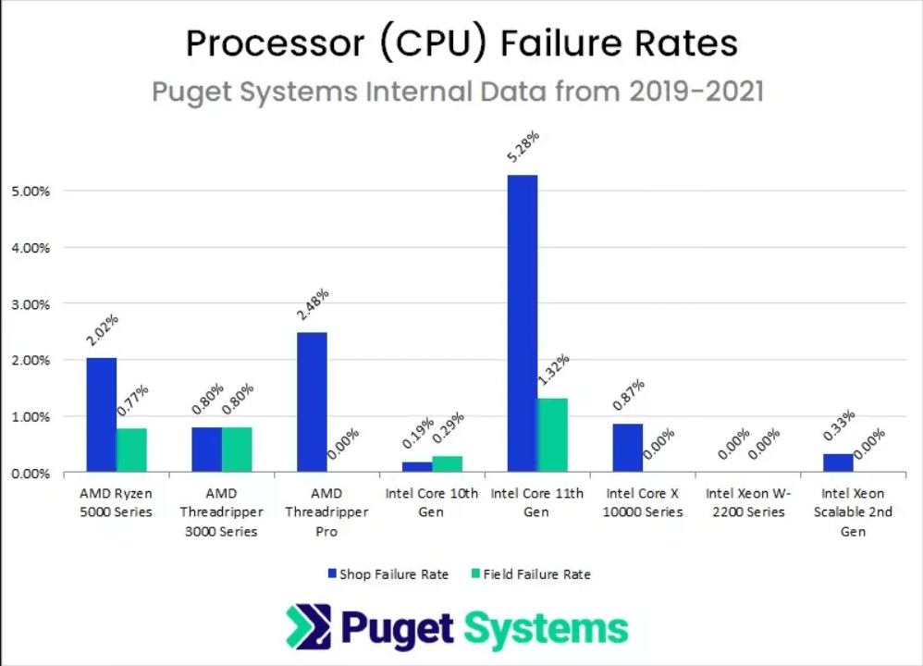
Failure Rates of Modern Hardware
CPU – Main processing component that is present in all computers
GPU – Graphics Processing component that is only present in higher performance computers
Notes:
Satrant
How can these simulated attacks model the real world?

Slide 15
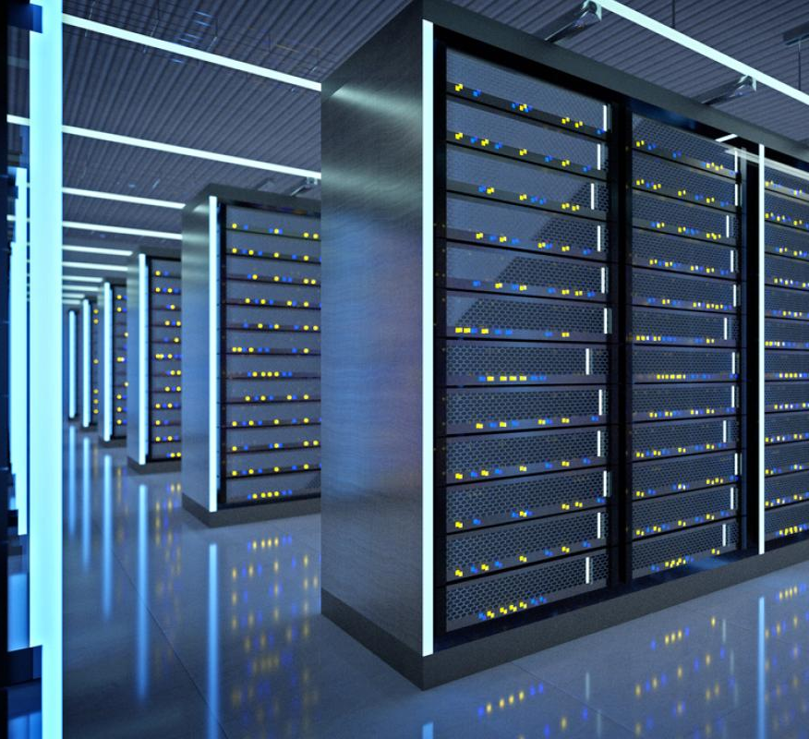
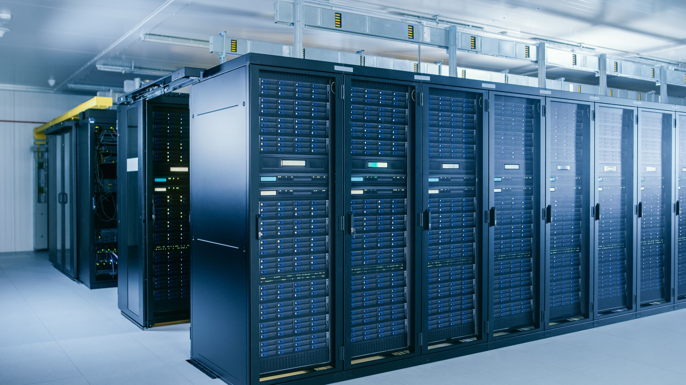

100,000 GPUs with 2% failure → 2,000 failures
Notes:
https://www.superradiatorcoils.com/blog/water-quality-and-filtration-in-liquid-cooled-data-centers
https://news.microsoft.com/source/features/innovation/microsofts-virtual-datacenter-grounds-the-cloud-in-reality/
https://www.datacenterknowledge.com/industry-perspectives/why-metaverse-hinges-sustainable-data-centers

Slide 16
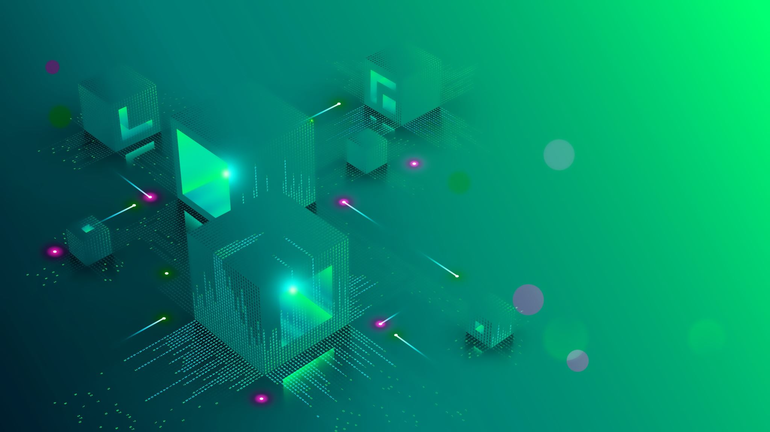
Background
Tensor – array of numbers, one dimensional or multidimensional
Parameters – internal variables that are learned during the training process and determine the performance of the network
Nodes – individual components of neural network that act as neurons to process information
Notes:
Liam
NLP, nodes, parameters

Slide 17
Error Injection Constraints
Quick Responses: 10-15 seconds
Variety of Responses
Avoid Over Error-Injection
Incorporate Bitflips
Notes:
Alex

Slide 18
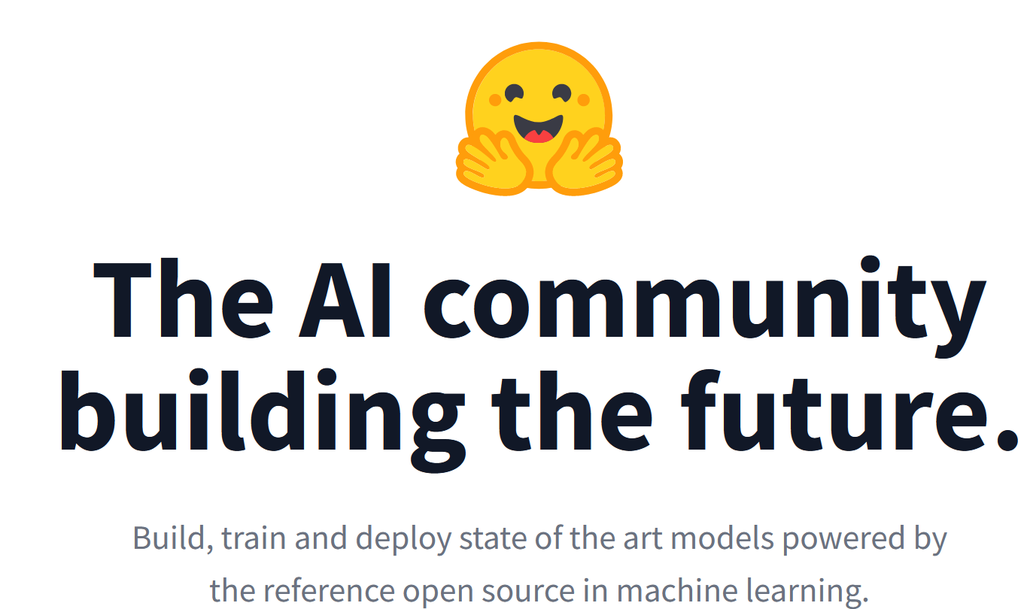
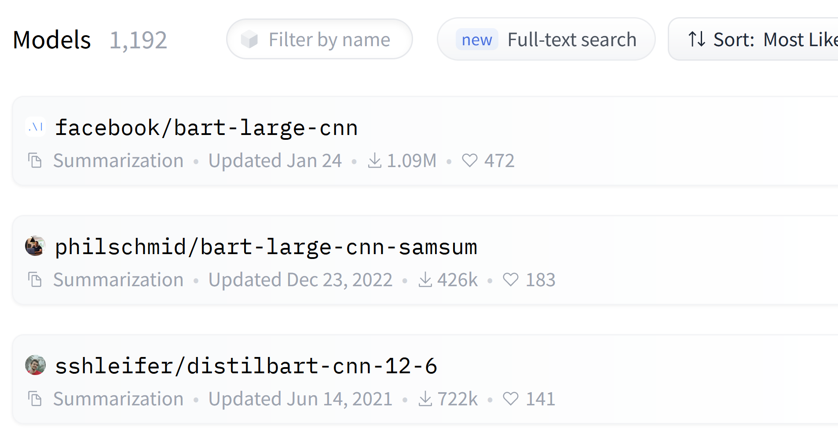
Limitations
Our project is developed for use with open-source Language Models through HuggingFace
Over 100,000 Language models
Project is applicable to all models
Open-source models are less advanced than ChatGPT
Text generation models were chosen for their more creative responses
They do not necessarily answer questions
HuggingFace.co
Notes:
- There were some limitations we faced with this project.
- The main being that we were forced to use Open-source models only.
- These open-source models are less advanced than ChatGPT but that does not take away from what our project could show
- Open-source models were accessed through huggingface which contains over 100,000 NLP models.
- Our project is potientially applicable to all of these models
- For the purposes of this presentation, we chose a model call Bart which was developed by facebook, because we found it to give the most creative results

Slide 19
System Chart
Error Injector
Unaltered Output:
“Once upon a time was a time when the world was a very different place…”
Natural Language Model
Prompt:
“Once upon a time”
Error-Injected:
“Once upon a time 486486486's486486 is a486486 vacancies vacancies panic”
Auto Error Injection
Error Injectors
Manual Error Injection
Bit Error Injection
Notes:
Satrant

Slide 20
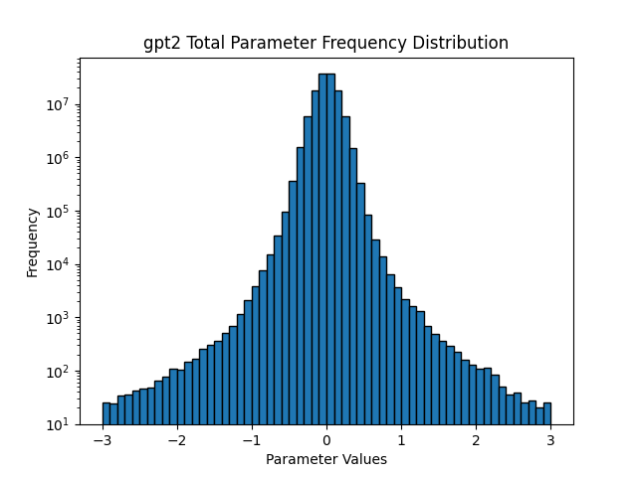
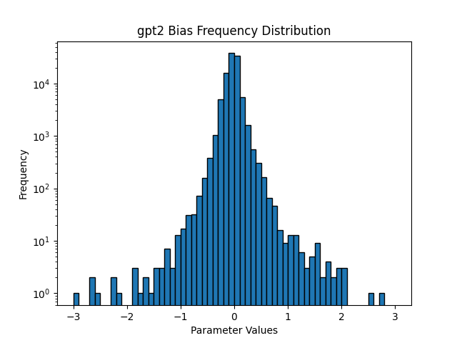

Plots of Parameter Distribution
Notes:
Satrant

Slide 21
Graph Optimization
Function graphs a range of 100 million to 1 billion parameters
Optimization through logic improvements in the code
Reduction in data type conversions
Graph time was reduced by 97% on average
Notes:
Liam
Add code, explain the improvements of our function

Slide 22
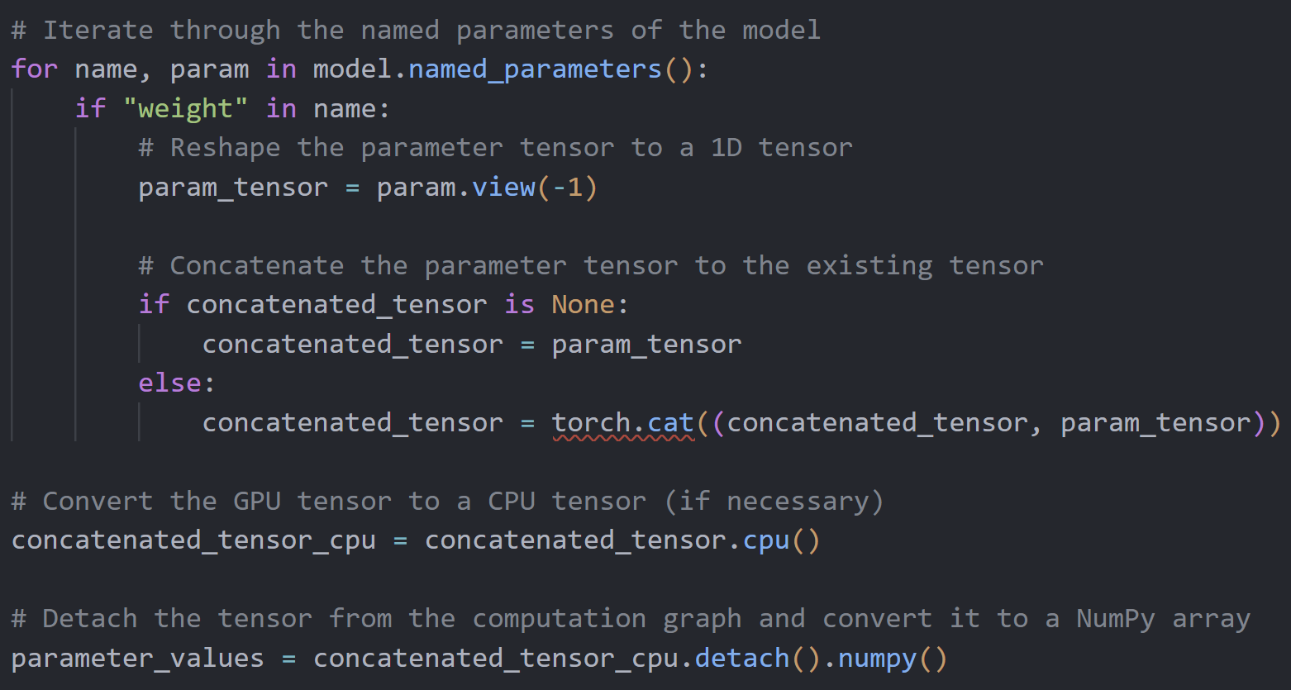
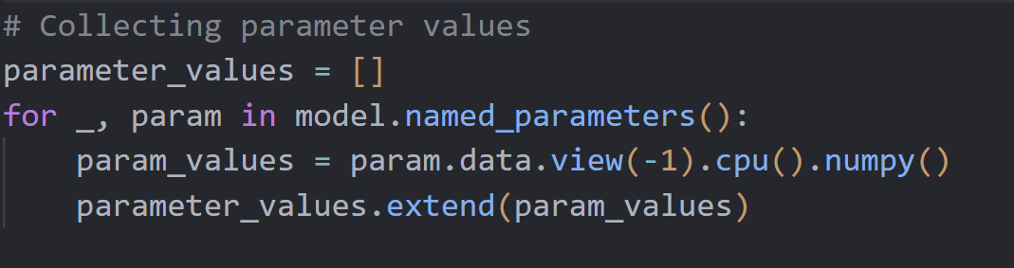
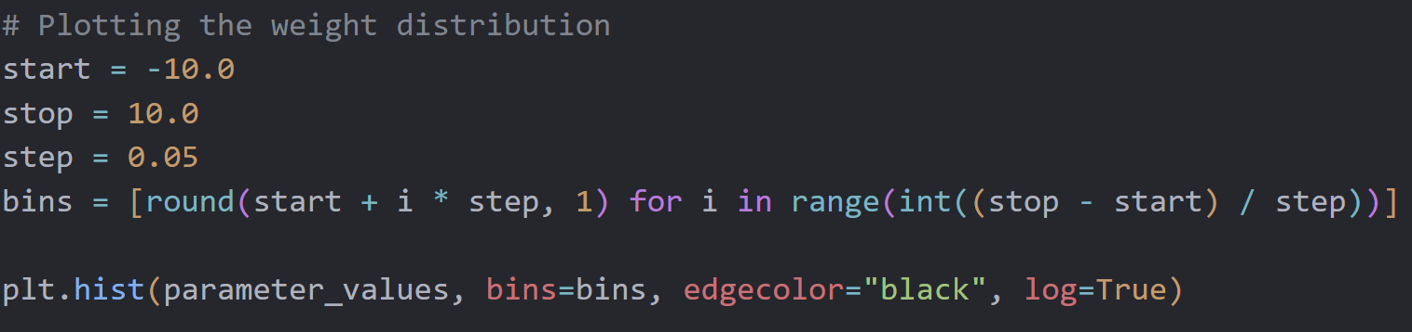
Optimizations
Optimized Parameter Collector
Initial Parameter Collector
Plot Distribution
Optimized Collector utilizes Pytorch command .cat instead of built in Python .extend
.cat is highly optimized for just tensors while .extend is built for generic combination of lists
Optimized Collector also converts entire tensor to NumPy outside of loop
Notes:
- The actual optimizations are pretty Python specific but we will happily go further into it if anyone has any questions about it.
- The main optimizations came in the form of utilization of the Pytorch function .cat over the generic python function .extend.
- The .cat function is specifically developed for our use case.

Slide 23
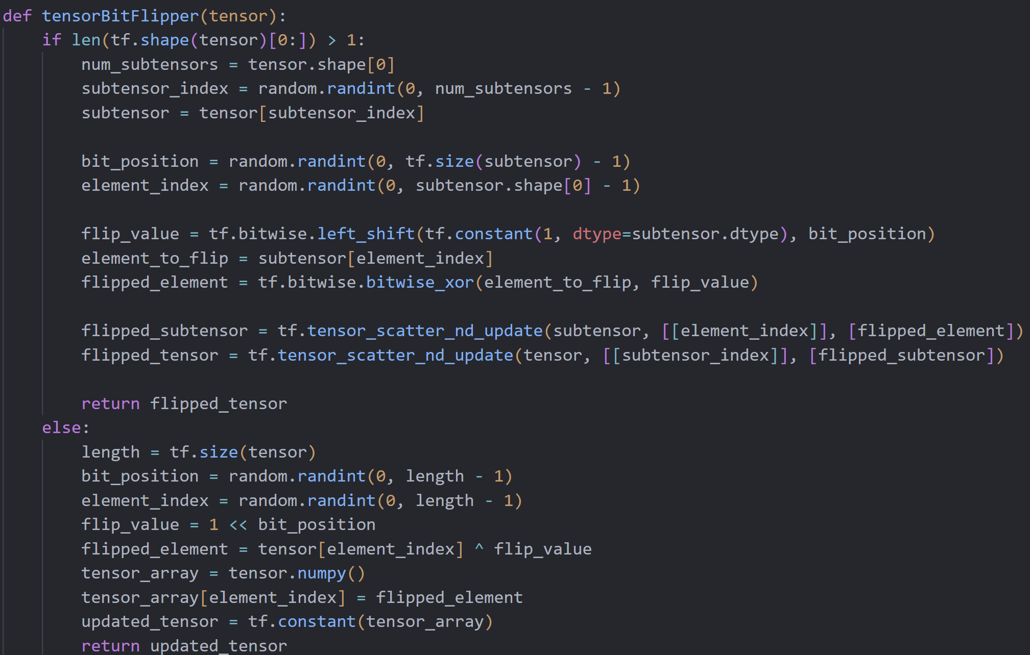
Bit Flipper Function
5 | 3 | 2 | 100
10 | 20 | 30 | 40
1 | 2 | 3 | 4
Input a tensor of any dimensions
Selects a random element and flips a singular bit
Could not be used in NLP models because of TensorFlow
5 | 3 | 2 | 100
10 | 20 | 30 | 40
1 | 2 | 3 | 0
Notes:
Liam
Summarize this slide so that we can go more in depth into the working functions. Use this slide to explain tensors

Slide 24
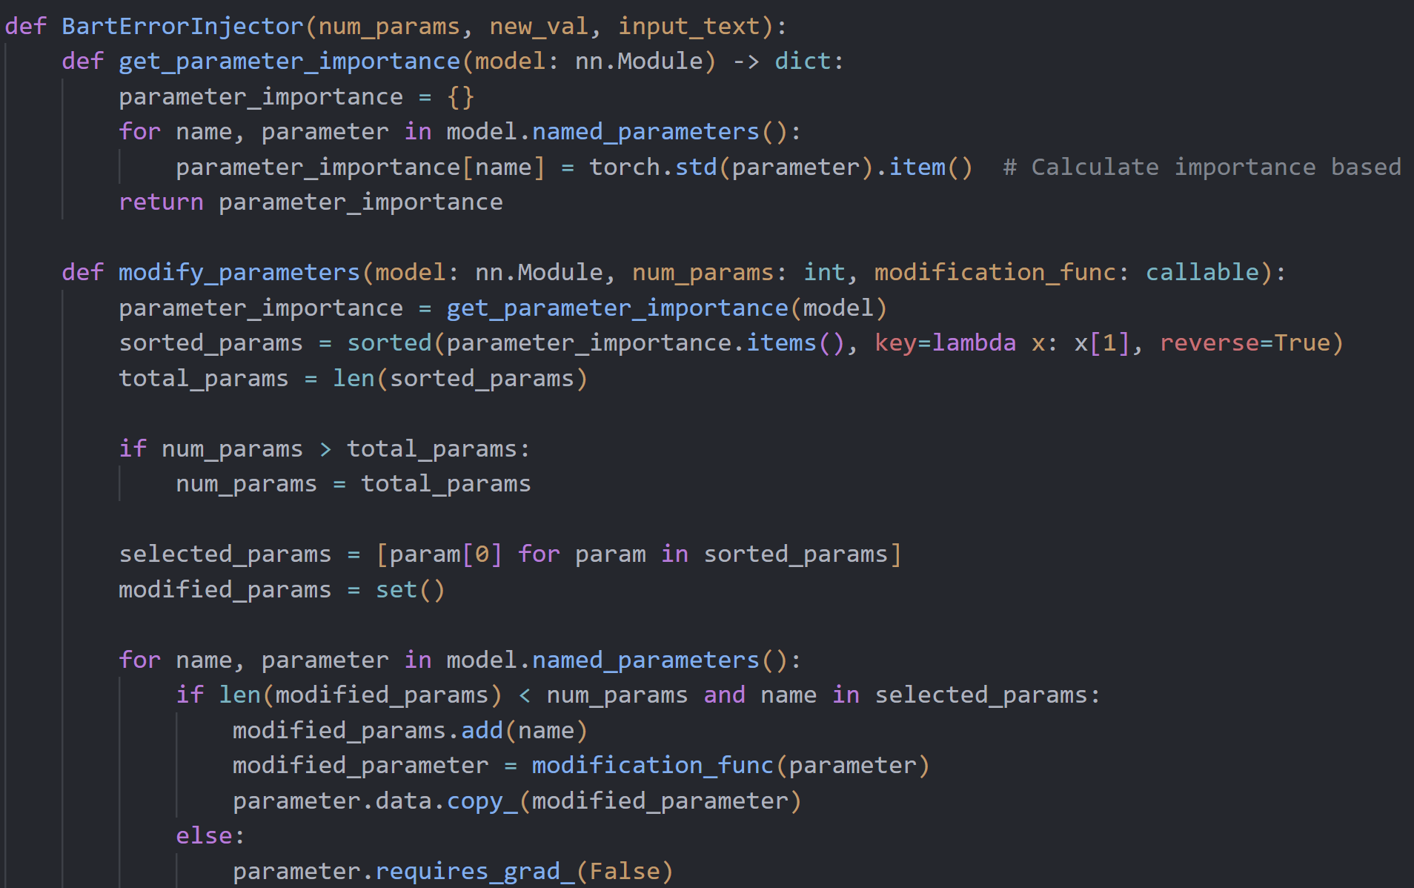
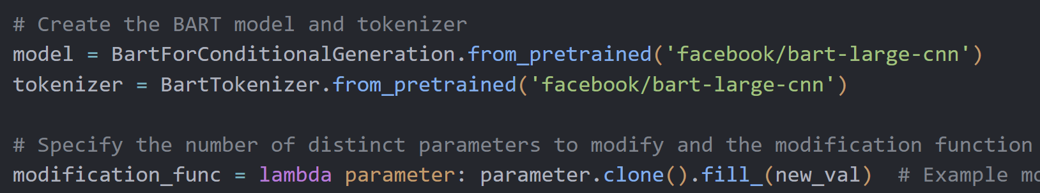

Auto Error Injection
Input number of tensors of parameters to change and value to change them to
Selects tensors to change based on importance
Fills tensors with new value
Notes:
Alex

Slide 25
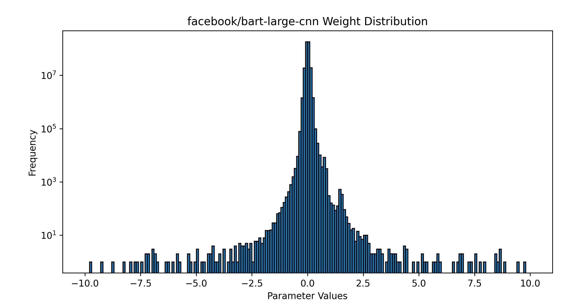
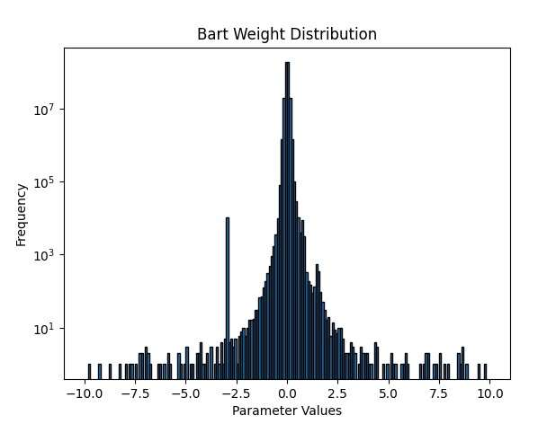
Pre-Auto Error Injection
Post-Auto Error Injection
Original Value ≈ 0
Average Value ≈ 0.0002493
New Value = -3
Average Value ≈ 0.0001734
Percent Difference ≈ 35.94%
Notes:
Alex

Slide 26
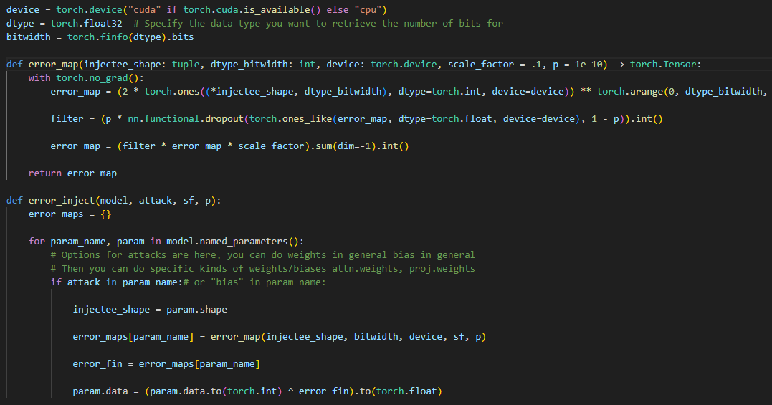
Manual Error Injection
Input model you want to attack, what node you want to attack, and two variables for randomness.
Attacks nodes by performing logical operation of XOR.
Useful for choosing specific nodes for attacks
Notes:
Satrant

Slide 27
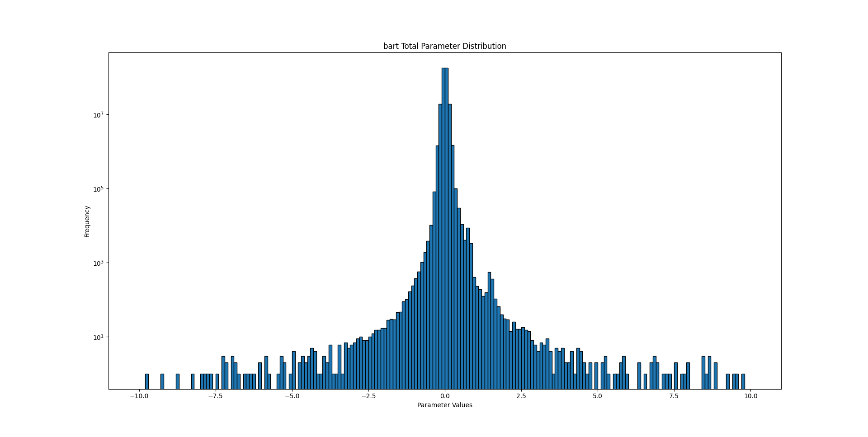
Bart Pre-Manual Error Injection
Original Average ≈ 0.0002493

Slide 28
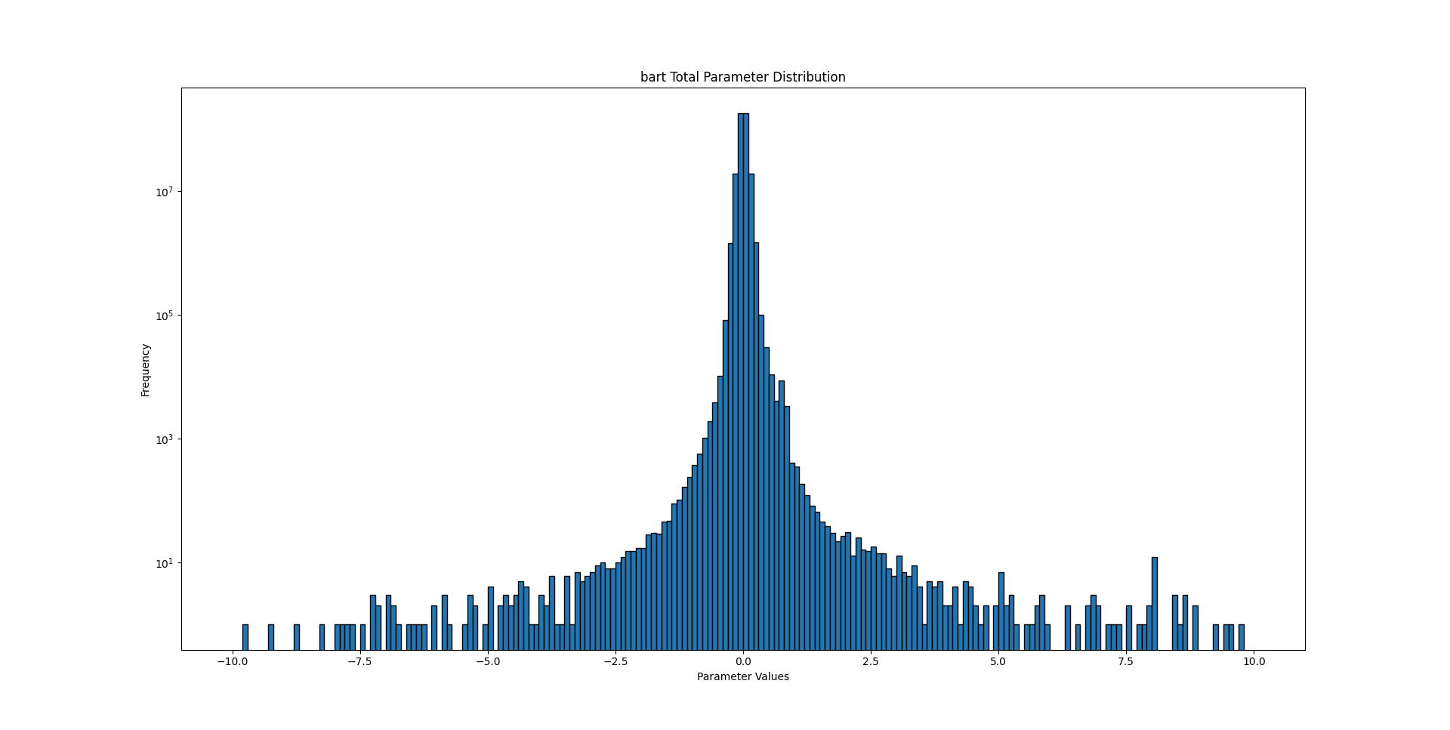
Bart Pre-Manual Error Injection
New Average ≈ -8156.1381
Percent Difference ≈ 200%

Slide 29
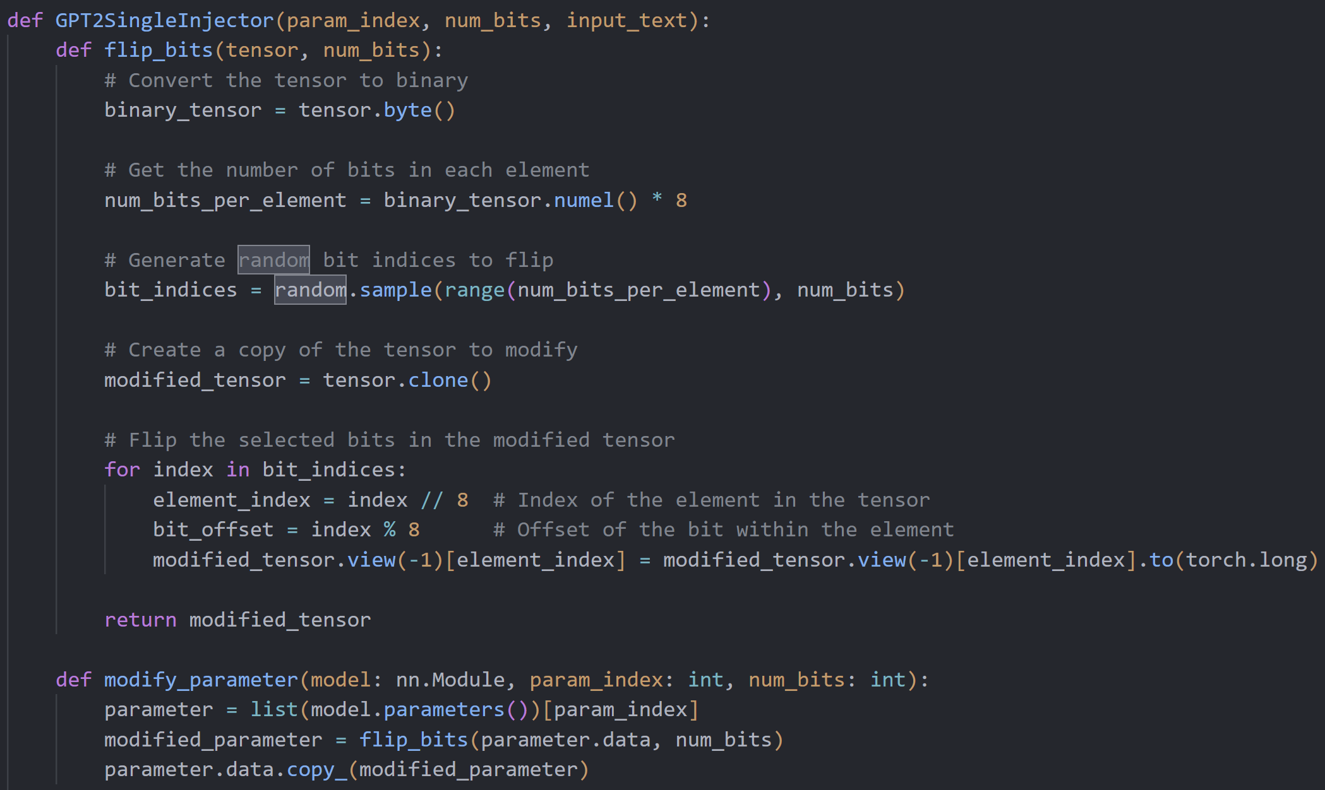
Bit Error Injection
Input tensor by index and number of bits to flip
Converts tensor to binary, flips number of bits specified and converts back to decimal
Notes:
Alex
I think we could get a much better example for this: maybe something about US history?
We are not totally sure about this function. What we expect is not always what happens

Slide 30
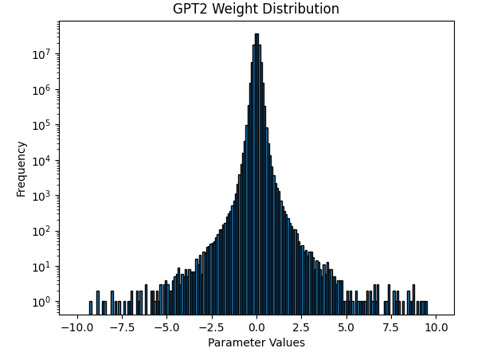

Pre-Error Injection
Post-Error Injection
Bart
Bart
Original Average ≈ 0.0002493
New Average ≈ 0.0002495
Percent Difference ≈ 0.0748%
Notes:
Alex

Slide 31
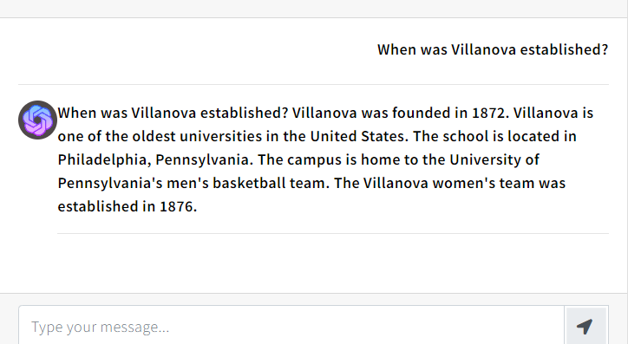
Bart - Original

Slide 32
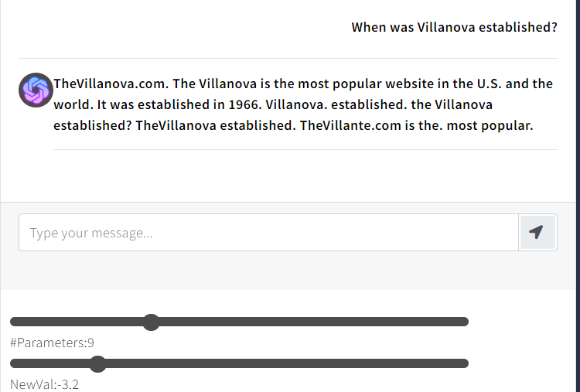
Bart – Auto Error Injection

Slide 33
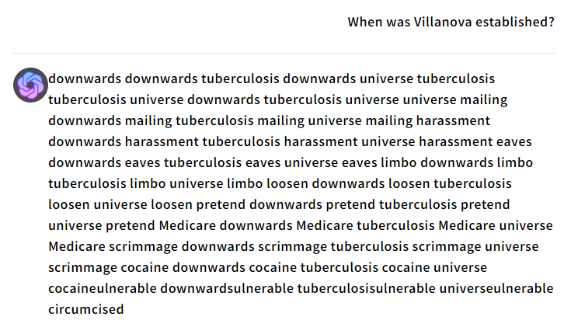
Bart – Manual Error Injection
Attacked v_proj.bias
Dropout rate: 0.09
Scale Factor: 0.1

Slide 34
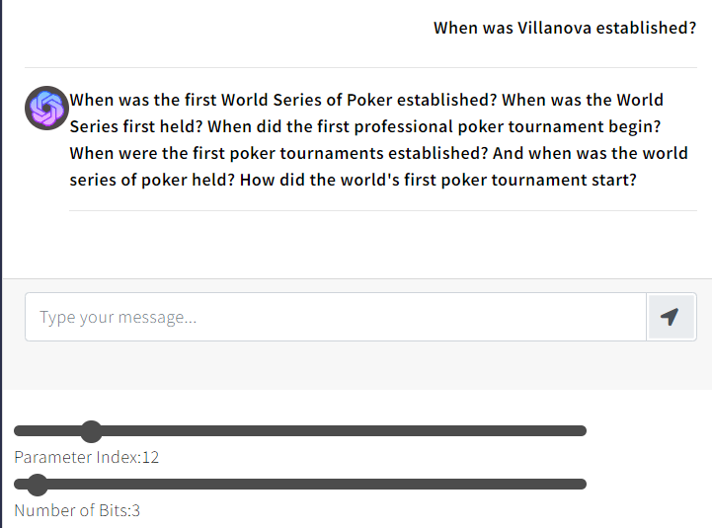
Bart – Bit Error Injection
Notes:
The amount of testing we performed was fairly minor but was as much we could do given our 8-week time constraint. So, the conclusions we could draw from injecting these models with errors are not as in depth as they would be if we had less limitation on time. It is evident that the 4 models we tested on, gpt2, bert, bart, and Roberta, are very sensitive to these error injections, even with bit error injection, the output is still vastly different. In the future, we’d like to be able to draw more analytical conclusions with our tool through high level observation.

Slide 35
Key Takeaways
Name | Method | Response Time | Strengths | Shortfalls
Auto Error Injection | Picks the most frequent parameter tensor automatically | 10 s | - Simple, Fast | - Responses can be illegible - Repetitive outputs - Over-injects errors
Manual Error Injection | Allows user to pick a node to inject errors onto | 30 s | - More interesting results - Control of parameters | - Slow - Changes entire node - Memory intensive
Bit Error Injection | Allows user to pick a specific tensor and number of bit flips to inject into the tensor | 15 s | -Variation of results -Uses bit flips -Subtle errors -Shows progressively erroneous outputs -Fast | - Hard to see errors through graph -Deeper analysis of results needed
Notes:
Kieran

Slide 36
Conclusions
The amount of testing we performed was relatively minor.
It is evident that the 4 models we tested on – GPT-2, Bert, Bart, and RoBERTa, are all very sensitive to these error injections.
In the future, we’d like to be able to draw more analytical conclusions with our tool through higher level observation

Slide 37
Website Considerations
Check out our website: sheaa.tech
Generate interest of AI developers to take away key information from our project
We decided that a website would be the best way to showcase our results regarding ease of use for a general audience.
The bulk of our project’s focus was on implementing the error injection functions into the models from huggingface.
Notes:
Liam
Maybe focus on the reasoning for why we want to make a website instead of the constraints. We want the general audience to play around with our project to get a better understanding of what we are doing. In addition, for developers to try to use our project through code it would take around 3 hours to get everything running. The website gives a developer the ability to quickly see the capability of our project and generate their interest.

Slide 38
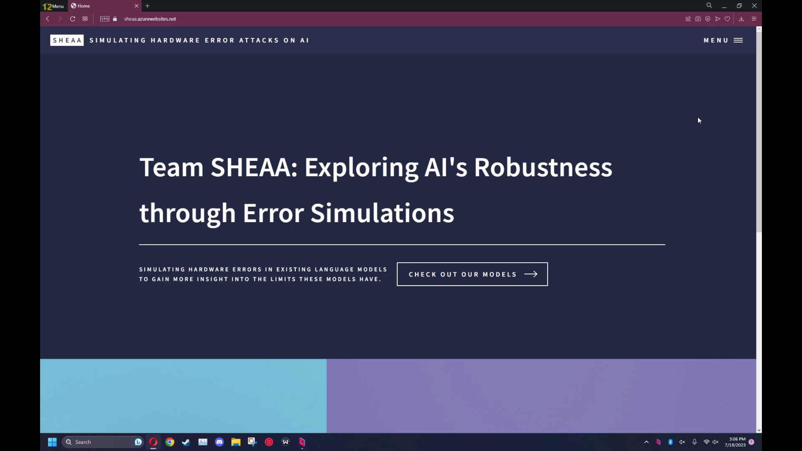

Slide 39

Future Plans
Our project lacks any data-based conclusions due to not having way to gather data on a large scale
Create benchmark tool to test the different models on their ability to resist simulated hardware attacks
Repeat process over a long period of time to gather data on the models tested
Implement error injection into Llama 2
Research Paper
Compiling the technical aspects of our project into a Research Paper with the help of our mentor, Dr. Xun Jiao
Notes:
Liam
Highlight that we want to do experimentation and validation
Could make applicable to larger models like gpt4?

Slide 40

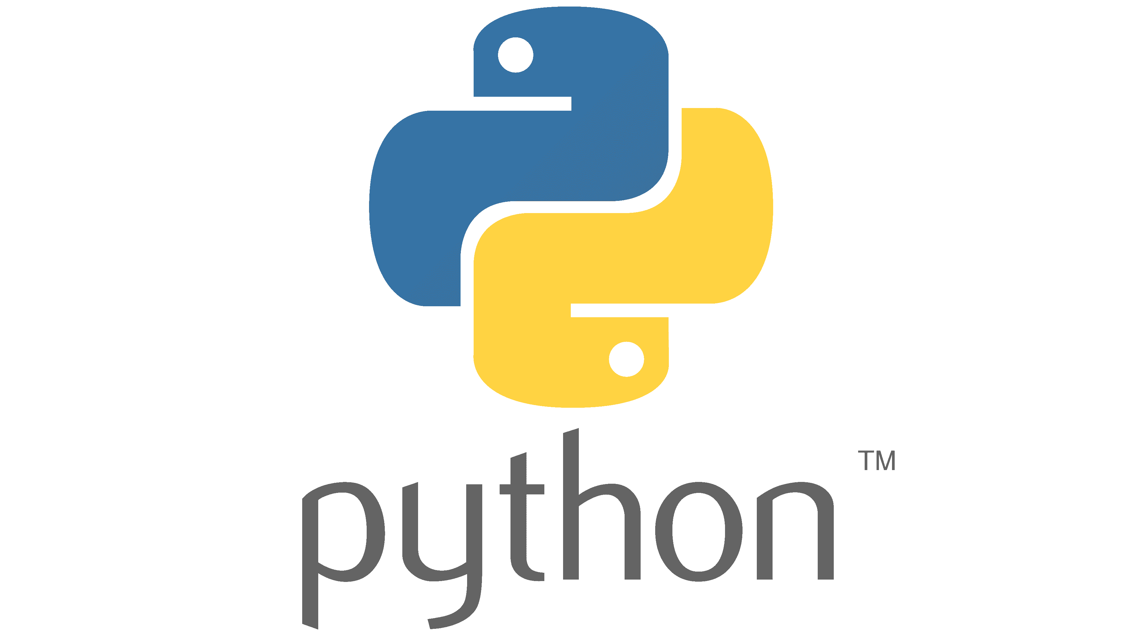
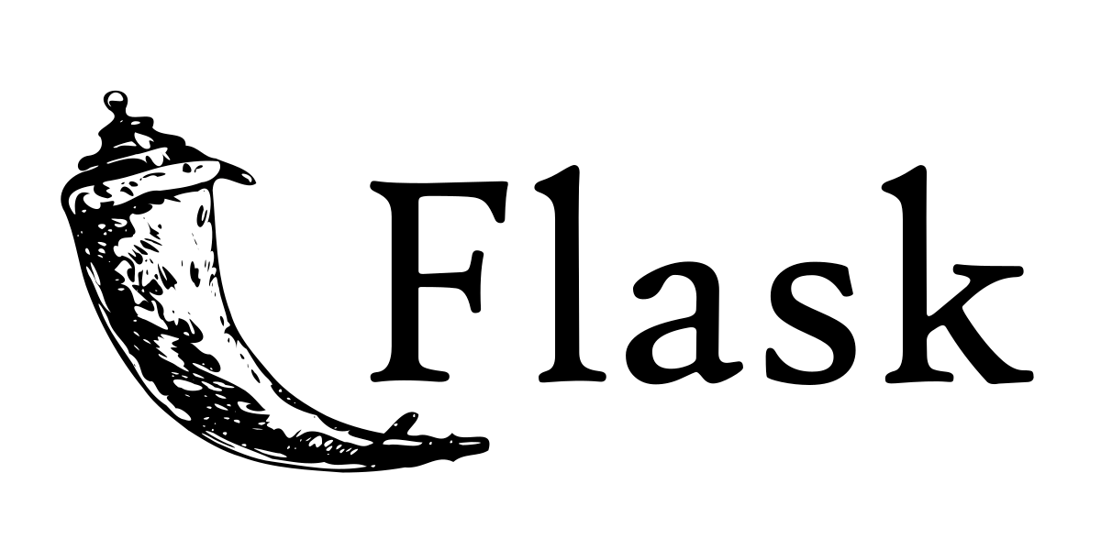

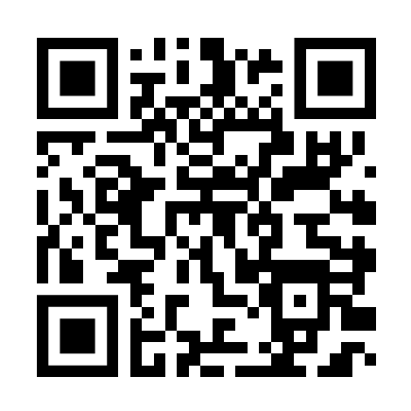



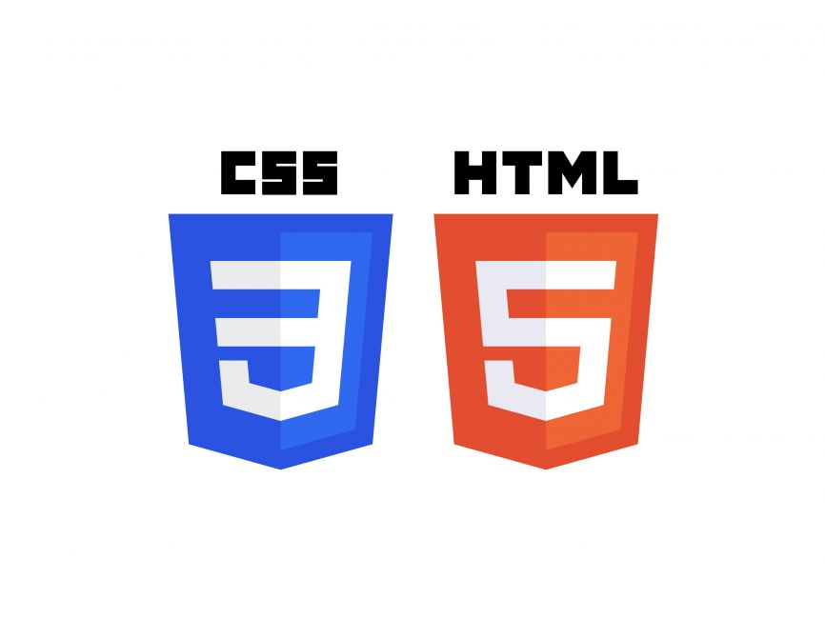

Tools and Codebase
Star us on GitHub!
https://github.com/liambaker10/SHEAA
Notes:
Liam

Slide 41
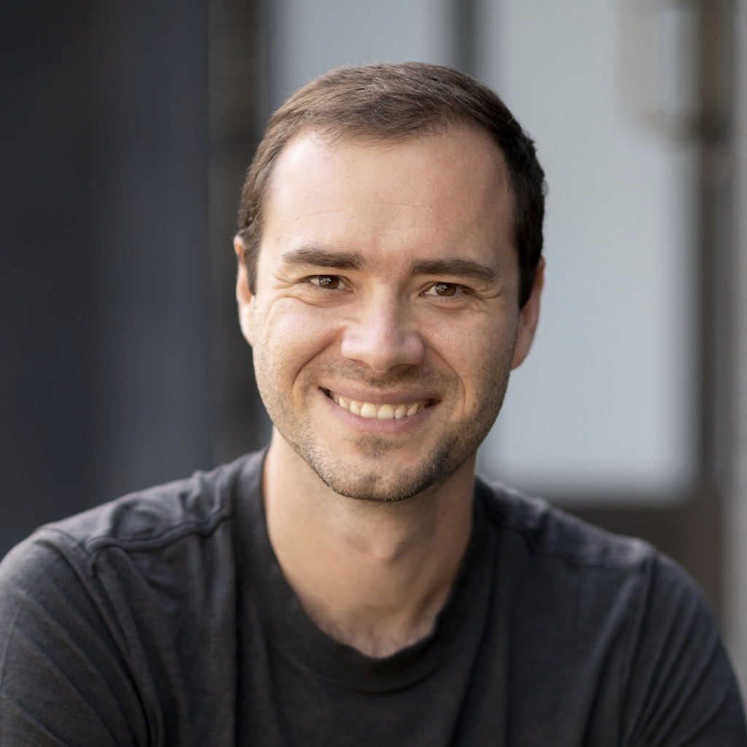
Sources and Inspiration
https://www.statista.com/chart/29174/time-to-one-million-users/
https://www.bloomberg.com/news/articles/2023-01-23/microsoft-makes-multibillion-dollar-investment-in-openai
https://fortune.com/2023/02/04/google-invests-300m-anthropic-openai-rival-making-chatgpt-challenger-claude-ai-chatbot-battle/
https://www.independent.co.uk/news/science/subatomic-particles-cosmic-rays-computers-change-elections-planes-autopilot-a7584616.html
https://www.pugetsystems.com/labs/articles/most-reliable-pc-hardware-of-2021-2279/
Ruixuan Wang: Grad Student at Villanova
Manual Error Injection was inspired by his research
Andrej Karpathy

Slide 42



Thank You!
Any Questions?
GitHub
Website: sheaa.tech

Slide 43
Website testing

Slide 44


Slide 45

Models | Task | Dataset | Year Released | Open-source | Founder | Parameter Count
Bart | Text Generation | CNN, Wikipedia | 2020 |  | Facebook
GPT-2 | Text Generation |  | 2019 |  | OpenAI
GPT-3.5 | Question Answering |  | 2022 |  | OpenAI

Slide 46
Optimizations
Initial Parameter Collector
Optimized Parameter Collector
Plot Distribution
Optimized Collector utilizes Pytorch command .cat instead of built in Python .extend
.cat is highly optimized for just tensors while .extend is built for generic combination of lists
Optimized Collector also converts entire tensor to NumPy outside of loop
Notes:
Kieran
Add github right after?

